Slide 1
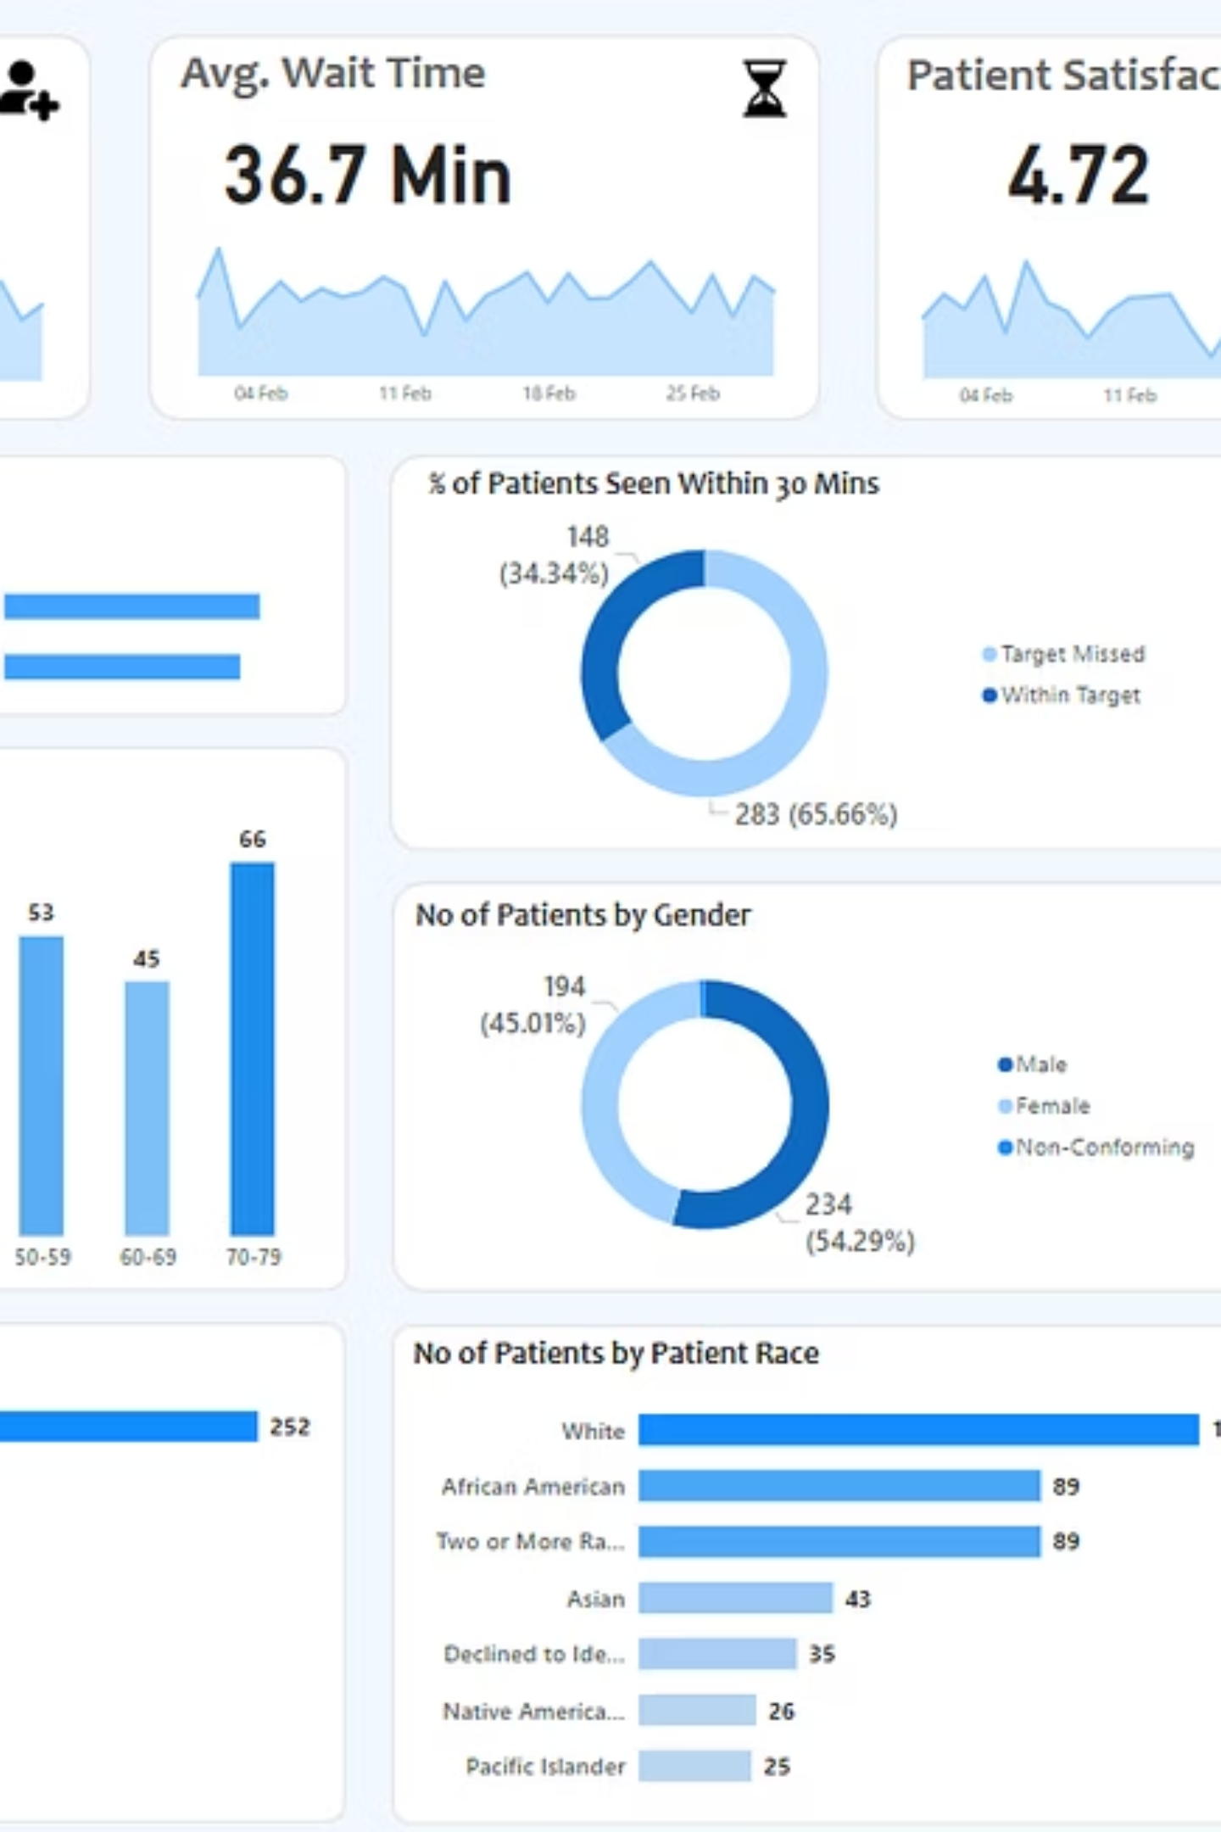
Hospital Emergency Room Dashboard
A comprehensive Power BI solution for optimizing emergency department operations, patient flow, and care delivery through data-driven insights.

Slide 2

PROJECT OVERVIEW
Project Implementation Steps
01
02
03
Requirement Gathering
Data Walkthrough & Connection
Data Cleaning & Quality Check
Align with stakeholders to define business requirements and key performance indicators
Review data sources and establish reliable connections to hospital systems
Ensure data accuracy, consistency, and completeness for reliable analysis
04
05
06
Data Modeling & Processing
DAX Calculations
Dashboard Development
Structure relationships and create calculated fields for comprehensive reporting
Build custom measures for KPIs including wait times, satisfaction scores, and trends
Design layouts, develop visualizations, and format charts for optimal user experience
07
Insights Generation
Extract actionable recommendations to drive operational improvements

Slide 3

Four Integrated Dashboard Views
Monthly View
Consolidated View
Track performance metrics and trends on a month-by-month basis to identify seasonal patterns and improvement opportunities
Comprehensive summary of hospital performance across customizable date ranges for strategic decision-making
Patient Details
Key Takeaways
Granular patient-level data grid enabling detailed analysis and operational troubleshooting
Actionable insights and recommendations derived from comprehensive data analysis across all metrics

Slide 4




KPIS
Core Performance Indicators
Track essential metrics to enhance operational efficiency and enable data-driven decisions for emergency department management and patient care optimization.
Total Patient Volume
Average Wait Time
Patient Satisfaction Score
Department Referrals
Daily patient count with area sparklines revealing peak days, seasonal trends, and capacity planning needs
Time from arrival to first medical contact, tracked daily to identify bottlenecks requiring operational adjustments
Daily service quality ratings with trend analysis to correlate satisfaction with operational challenges and peak times
Daily referral counts by department, identifying high-volume areas that may require additional resources and support

Slide 5

Patient Admission
Department Referrals
Demographics
Admitted vs non-admitted ratios
Where patients are sent
Gender and population data
DASHBOARD 1
Monthly Performance View
Monitor key metrics and trends on a month-by-month basis to identify patterns and areas for improvement in emergency department operations.
Age Distribution
Timeliness Metrics
Patient age group breakdown
Wait and treatment times
Patient Admission Status
Track admitted vs. non-admitted patient ratios
Age Distribution Analysis
Group patients by 10-year intervals for demographic insights
Department Referral Trends
Analyze patterns across specialties and departments
Timeliness Metrics
Measure percentage of patients seen within 30 minutes
Demographic Breakdowns
Visualize patient distribution by gender and race
Time-Based Volume Analysis
Assess patient flow by day of week and hour of day

Slide 6

DASHBOARD 2
Consolidated Performance View
Provide a holistic summary of hospital emergency department performance across customizable date ranges, enabling strategic planning and trend analysis.
Flexible Date Range Selection
Aggregated Metric Analysis
Comparative Trend Identification
Analyze performance across any custom time period—weekly, quarterly, or annual views—for comprehensive strategic insights
Similar metrics to Monthly View dashboard but consolidated across broader time frames to reveal long-term patterns and performance trajectories
Compare performance across multiple time periods to identify improvements, seasonal variations, and areas requiring sustained attention

Slide 7
DASHBOARD 3
Patient-Level Data Grid
Granular insights into individual patient records enable detailed analysis, quality assurance reviews, and operational troubleshooting at the most specific level.
Detailed Analysis Capabilities
Filter and sort patient records by any field to investigate specific cases, identify outliers, and conduct root cause analysis for operational improvements.
Patient ID
Unique identifier for tracking
Full Name
Patient identification
Gender
Demographic classification
Age
Patient age in years
Admission Date
Date and time of ER arrival
Race
Ethnic demographic data
Wait Time
Minutes before first contact
Department Referral
Specialty department assigned
Admission Status
Admitted or discharged

Slide 8




DASHBOARD 4
Key Takeaways & Strategic Insights
Comprehensive summary of findings from all dashboards, providing clear and actionable recommendations for stakeholders to optimize emergency room operations and enhance patient care delivery.
Descriptive Analysis
Detailed interpretation of each metric and visualization
Pattern & Anomaly Detection
Identification of trends, outliers, and areas of concern
Actionable Recommendations
Evidence-based strategies for operational optimization

Slide 9
Transforming Emergency Care Through Data
Enhanced Decision-Making
Improved Patient Experience
Operational Excellence
Real-time insights enable administrators to make informed operational decisions that improve patient outcomes
Reduced wait times and optimized resource allocation lead to higher satisfaction scores and better care delivery
Data-driven strategies optimize staffing, reduce bottlenecks, and increase emergency department efficiency
Ready to transform your emergency department operations? Let's discuss implementation and customization for your facility's unique needs.

